Slide 1
17
Introduction to C99

Slide 2
There is nothing like returning to a place that remains unchanged to find the ways in which
you yourself have altered.
  Nelson Mandela
Everything you can imagine is real.
  Pablo Picasso
...life is too full of rich possibilities to have restrictions placed upon it.
  Gloria Swanson

Slide 3
The return from your work must be the satisfaction which that work brings you
and the world’s need of that work.
  William E.B. Du Bois
Just never forget to be dexterous and deft
And never mix up your right foot with your left.
  Dr. Seuss

Slide 4
OBJECTIVES
In this chapter you will learn:
Many of the new features of the C99 standard.
Some key C99 features in the context of complete working programs.
To use // comments.
To mix declarations and executable code and to declare variables in for statement headers.
To initialize arrays and structs with designated initializers.
To use data type bool to create boolean variables whose data values can be true or false.
To create variable-length arrays and pass them to functions.
To perform arithmetic operations on complex variables.

Slide 5
17.1 Introduction
17.2 Support for C99
17.3 New C99 Headers
17.4 // Comments
17.5 Mixing Declarations and Executable Code
17.6 Declaring a Variable in a for Statement Header
17.7 Designated Initializers and Compound Literals
17.8 Type bool
17.9 Implicit int Return Type in Function Declarations
17.10 Complex Numbers
17.11 Variable-Length Arrays
17.12 Other C99 Features
17.13 Internet and Web Resources

Slide 6
17.1 Introduction
C99
  C99 is a revised standard for the C programming language
    Refines and expands the capabilities of C89 (ANSI C)
  C99 has not been widely adopted
    Not all compilers support it
  In this chapter, we discuss many of C99’s key features

Slide 7
17.2 Support for C99
Microsoft Visual C++ does not support C99
Instead, we use Bloodshed Software’s Dev-C++
  Free compiler
  Available at www.bloodshed.net/dev/devcpp.html
    To enable C99 support in Dev-C++, open the “Compiler Options” window in the “Tools” menu
    Check the box next to “Add the following commands when calling compiler”
    Add –std=c99 to the text box underneath

Slide 8
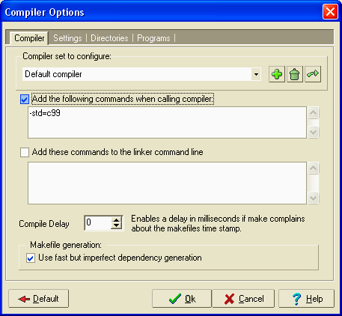
Fig. 17.1 | Compiler Options window in Dev-C++ 4.9.9.2.

Slide 9
17.3 New C99 Headers
C99 adds several headers for use with its new features
  List of new headers on next slide

Slide 10
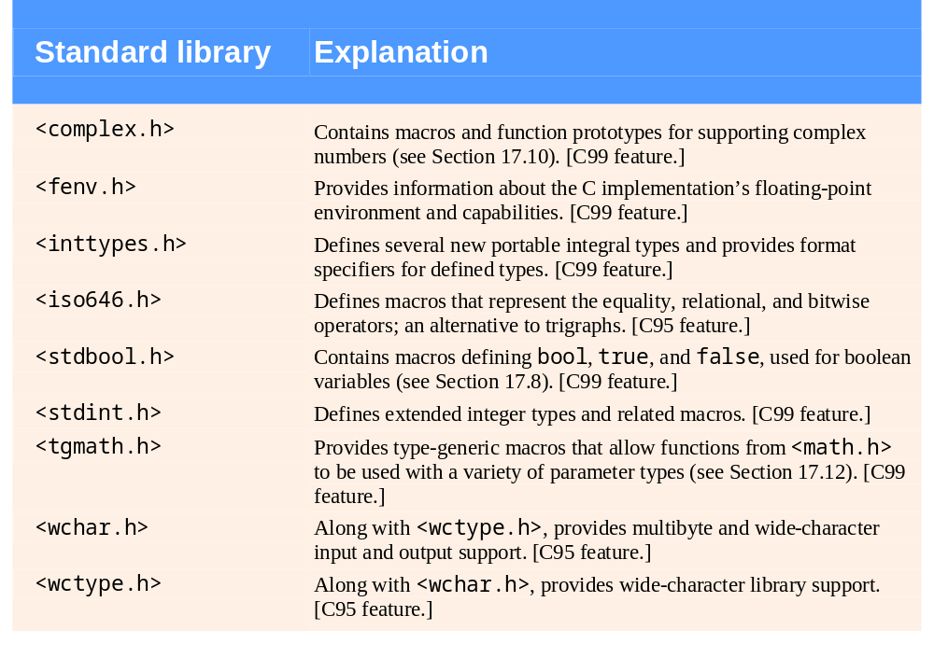
Fig. 17.2 | Standard library headers added in C99 and C95.

Slide 11
17.4 // Comments
// Comments
  In C89, only way to declare comments is with /* and */
  C99 allows the use of // for comments
  Any text following // is considered a comment
  However, // comments end at end of line

Slide 12
17.5 Mixing Declarations and Executable Code
Block scope variable declarations
  In C89, all variables with block scope must be declared at start of block
  In C99, variables can be declared anywhere within a block
  However, must make sure to declare variables before they are used

Slide 13
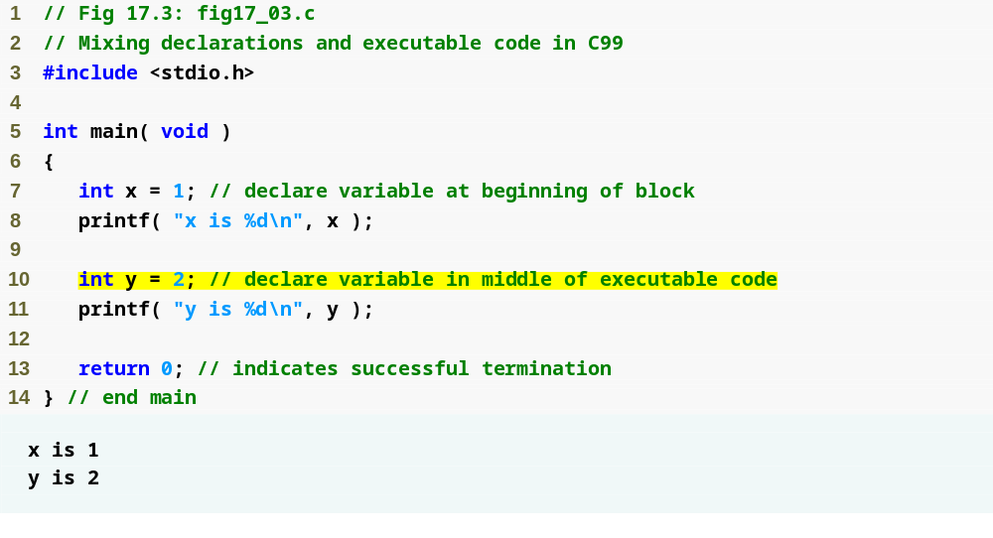
Outline
fig17_03.c
y is defined in middle of block without error

Slide 14
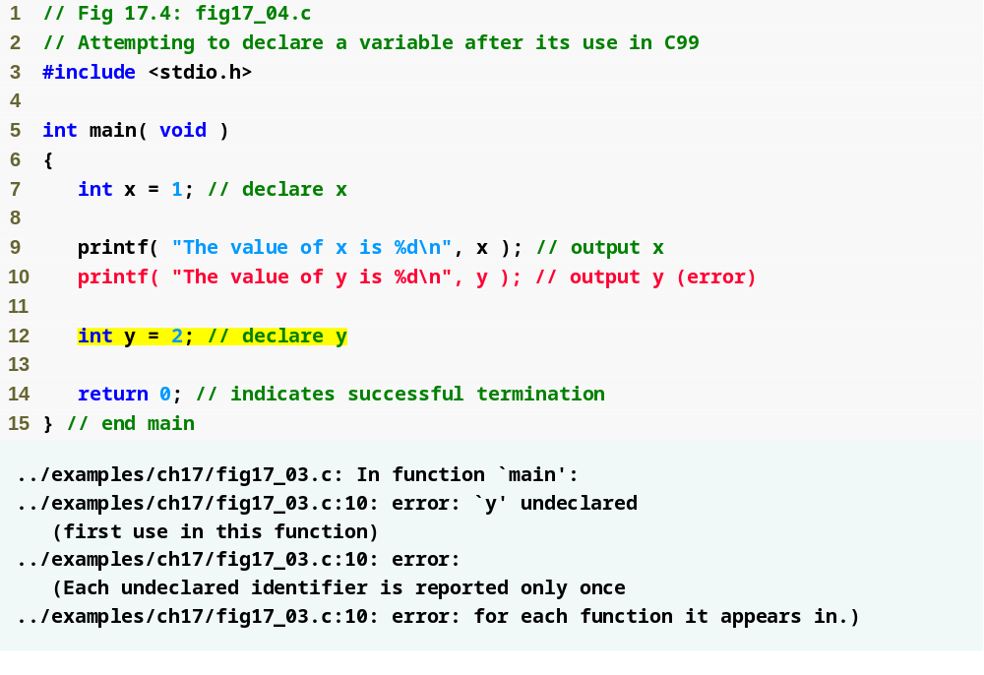
Outline
fig17_04.c
y has not yet been declared at this point in the code, so this line causes an error

Slide 15
17.6 Declaring a Variable in a for Statement Header
Variable declarations
  In C89, all variables with block scope must be declared at start of block, so for loop counters must be defined before the loop itself
  C99’s capability to mix declarations and executable code allows programmers to define for loop counters inside the loop header
  Variable declared in a for loop header has scope only for duration of loop

Slide 16
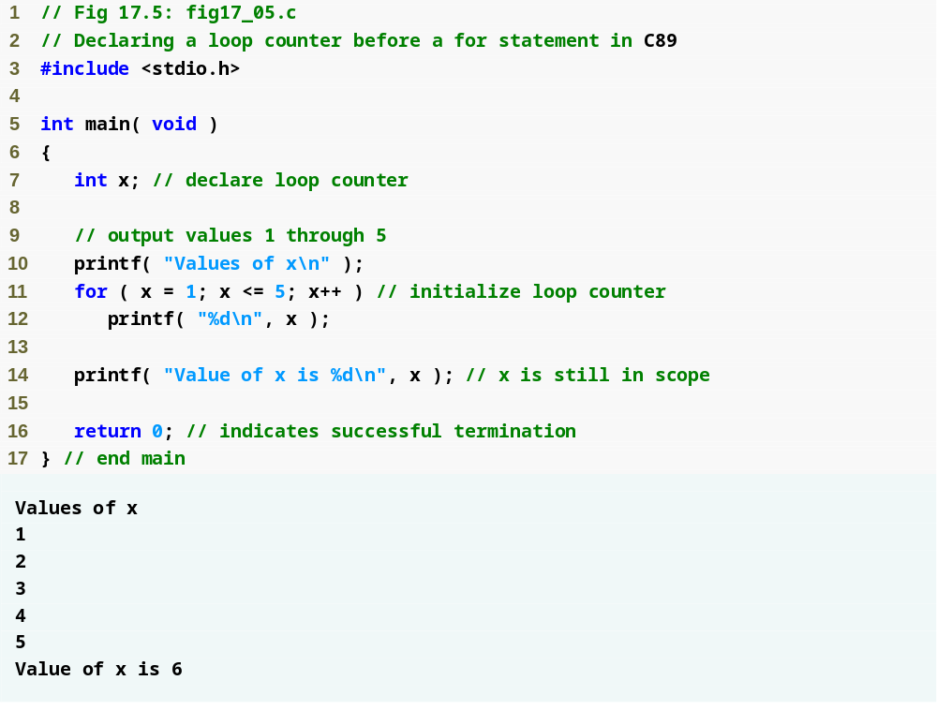
Outline
fig17_05.c
In C89, for loop counters must be declared before for loop actually starts

Slide 17
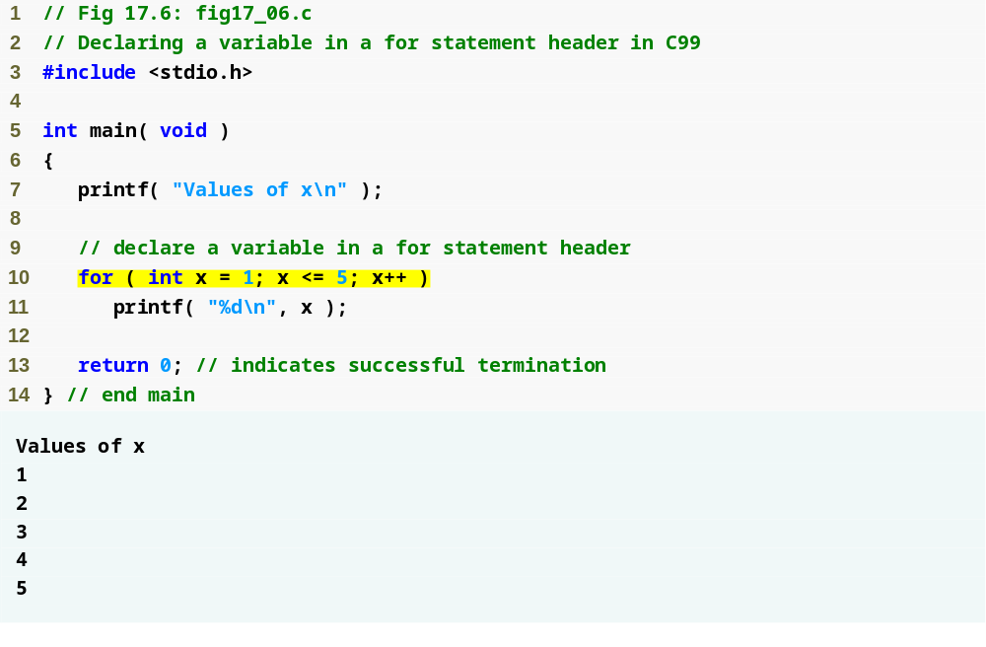
Outline
fig17_06.c
In C99, loop counters can be declared in for loop header

Slide 18
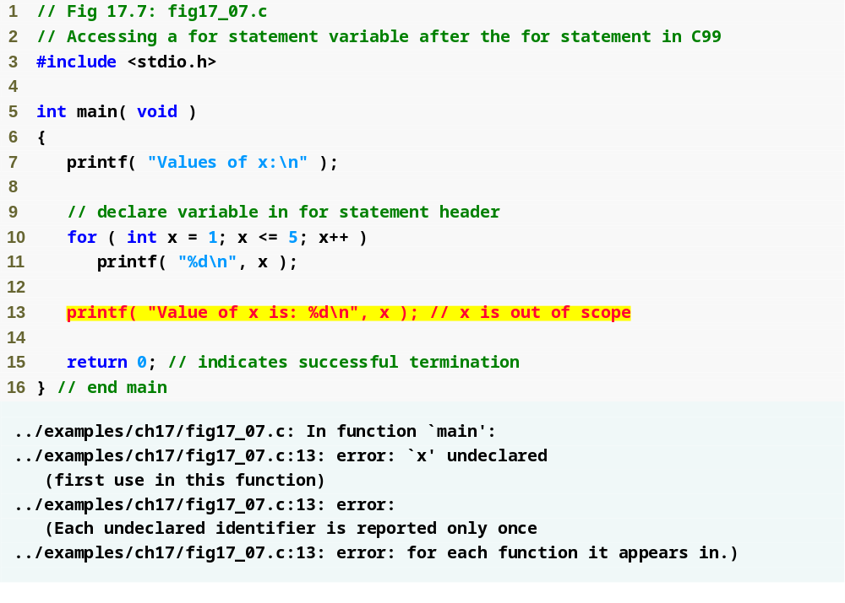
Outline
fig17_07.c
Variables defined in a for loop header have scope for only the loop, so this line causes an error

Slide 19
17.7 Designated Initializers and Compound Literals
Designated initializers
  In C89, cannot initialize only selected elements of an array, struct, or union
    Can initialize all elements, or first few elements, but cannot initialize, for example, only last element
  C99’s designated initializers allow initialization of only selected elements

Slide 20
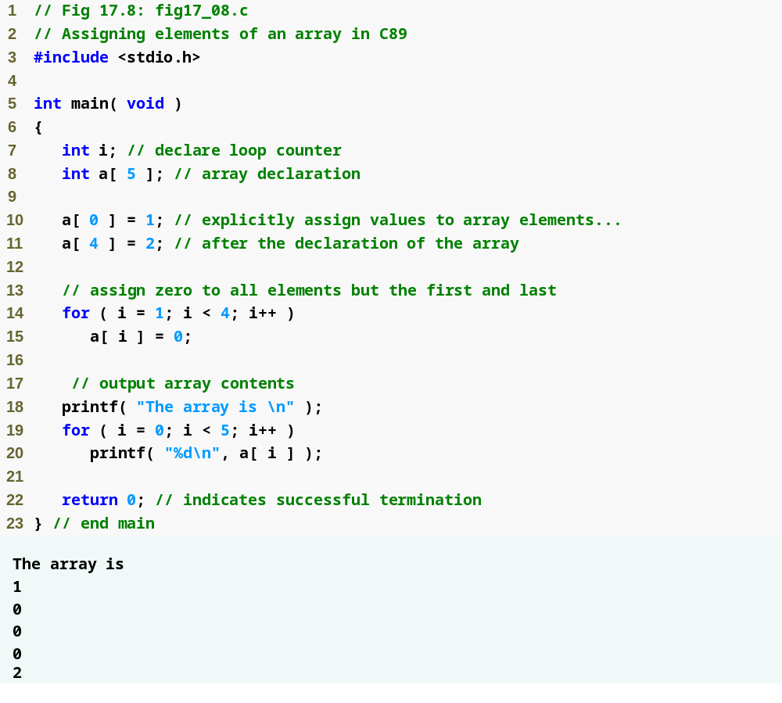
Outline
In C89, we can initialize the first element of an array in the declaration, but cannot initialize any one of the others without initializing all the elements before it
fig17_08.c
Must explicitly assign value to last element after array declaration

Slide 21
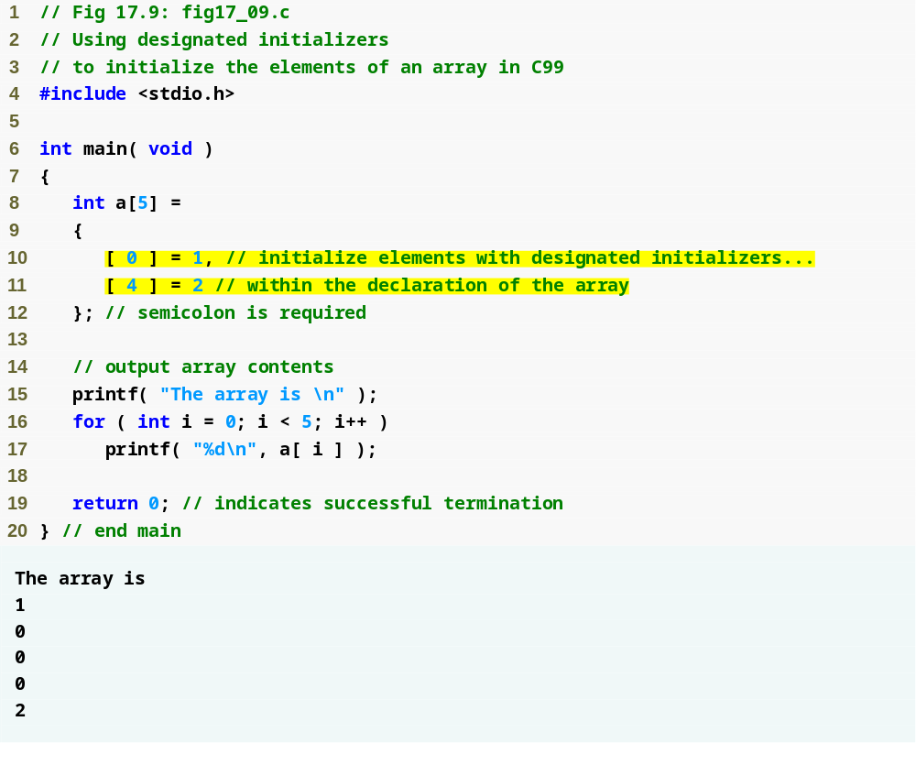
Outline
Separate designated initializers with commas
fig17_09.c
C99’s designated initializers allow only specific elements to be initialized

Slide 22
17.7 Designated Initializers and Compound Literals
Compound literals
  Designated initializers can be used to create what are called “compound literals”
  Allows programmer to create unnamed temporary arrays, structs, and unions
  If, for example, programmer wants to pass a temporary array to function demoFunction, he uses the code
demoFunction( ( int [ 5 ] ) { [ 0 ] = 1, [ 4 ] = 2 } );

Slide 23
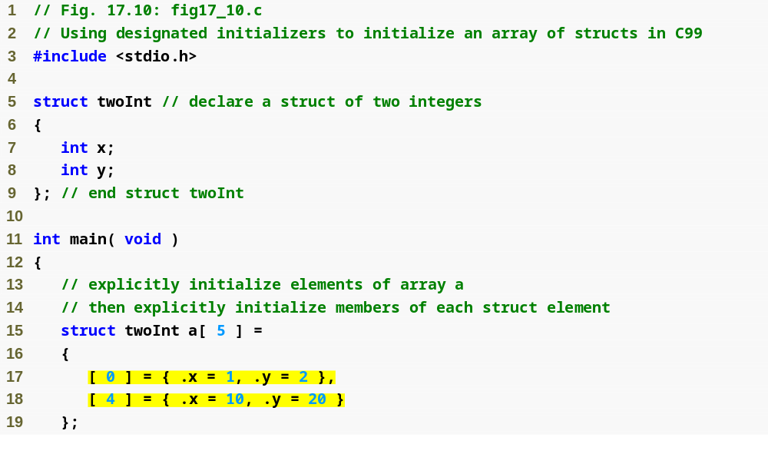
Outline
fig17_10.c
(1 of 2 )
Designated initializers can also be used to initialize specific elements of structs, like this

Slide 24
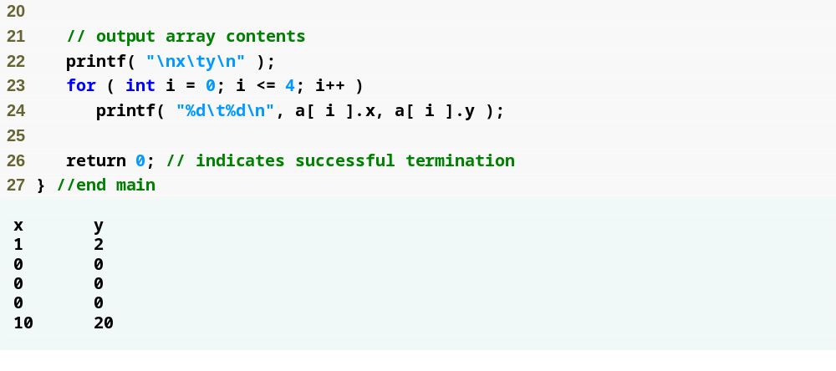
Outline
fig17_10.c
(2 of 2 )

Slide 25
17.8 Type bool
Boolean variables
  “True or false” variables
  Can hold only value of 0 or 1
  C89 has no Boolean variable type—considers 0 to be “false” and any other value to be “true”
  C99 provides Boolean variable type _Bool
  Also provides stdbool.h header that defines three symbolic constants
    bool, which evaluates to _Bool
    true, which evaluates to 1
    false, which evalutates to 0

Slide 26
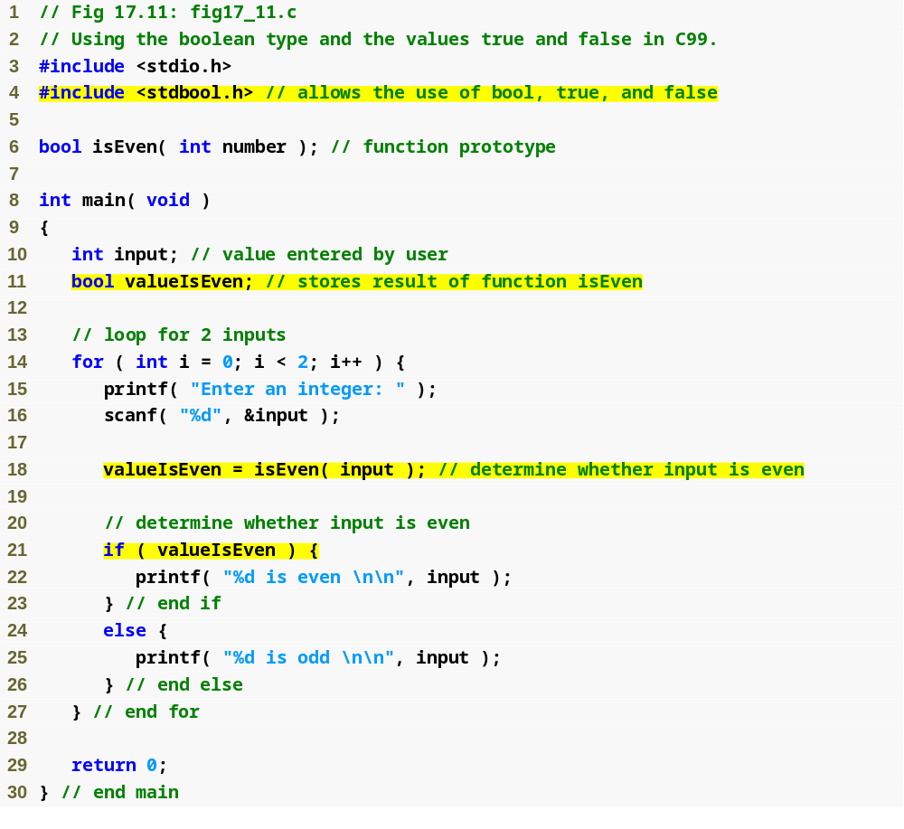
Outline
Include stdbool.h header to use bool, true, and false
fig17_11.c
(1 of 2 )
bool type variable can hold only 0 or 1
Remember that C considers 0 to be false and non-zero to be true

Slide 27
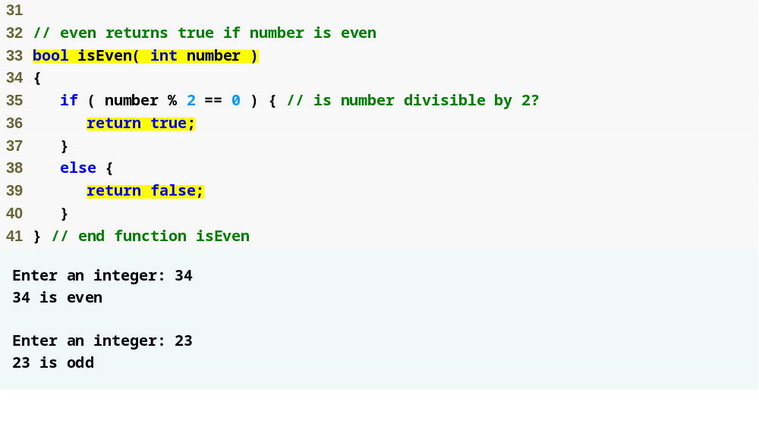
Outline
fig17_11.c
(2 of 2 )
true symbolic constant evaluates to 1
false symbolic constant evaluates to 0

Slide 28
17.9 Implicit int in Function Declarations
Implicit return types
  In C89, if a function does not have a specified return type or one of its arguments does not have a type, they are implicitly given a type of int
  In C99 this is not allowed; a function must be given a return type and its arguments must all have specified types or a compiler warning will be issued

Slide 29
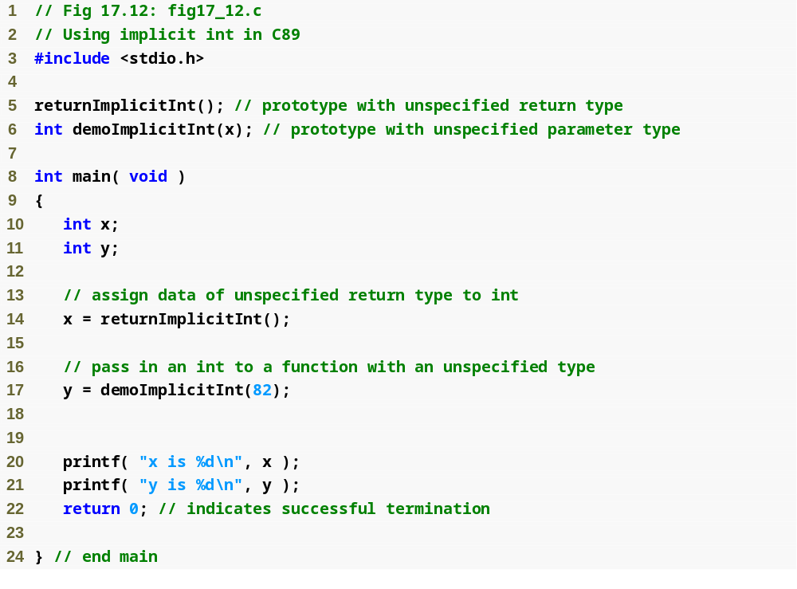
In C89 functions with no return type default to type int
Outline
fig17_12.c
(1 of 2 )
Likewise, arguments without a type default to type int

Slide 30
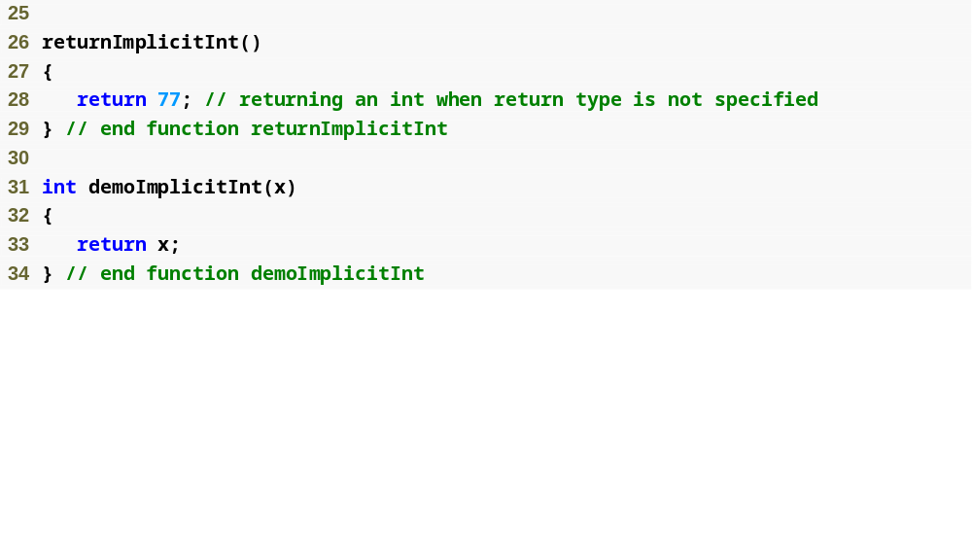
Outline
fig17_12.c
(2 of 2 )

Slide 31
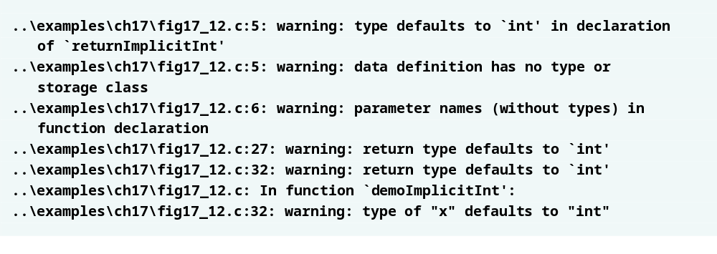
Outline
In C89 using implicit ints is allowed, but in C99 compiler warnings will occur

Slide 32
17.10 Complex Numbers
Complex numbers
  C99 adds support for complex numbers and arithmetic using the complex.h header
  Defines symbolic constant I that corresponds to i, the square root of -1
  Complex variables defined using complex type
  Note that complex can be combined with other types, e.g. double complex
  All arithmetic operations in C with complex numbers are done with same operators as regular numbers
  Exponents done with cpow function in complex.h header
  Function creal returns real portion of a complex number, and function cimag returns imaginary portion

Slide 33
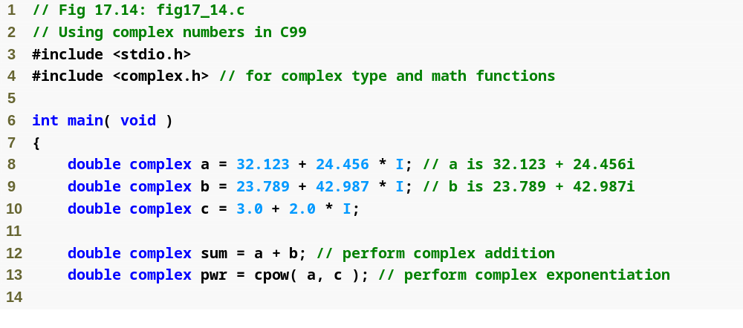
Outline
Include complex.h header to use complex numbers
fig17_14.c
(1 of 2 )
Declare complex variables with complex type
cpow function performs exponentiation with complex numbers

Slide 34
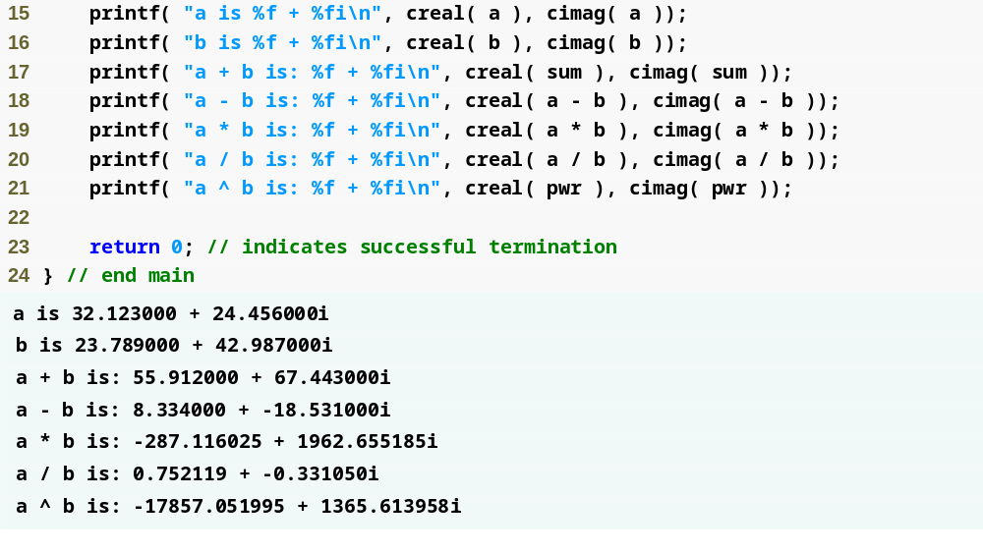
Outline
fig17_14.c
(2 of 2 )
creal function returns real portion of a complex number
cimag function returns imaginary portion of a complex number

Slide 35
17.11 Variable-Length Arrays
Variable-length arrays
  Does not refer to arrays whose size can change after they have been declared
  In C89, the size of an array must be a constant
  C99 allows array sizes to be set by variables
  Functions can also take arrays of variable length
  If function does not need to know the size of an array passed to it, array should be declared in function header as having size *

Slide 36
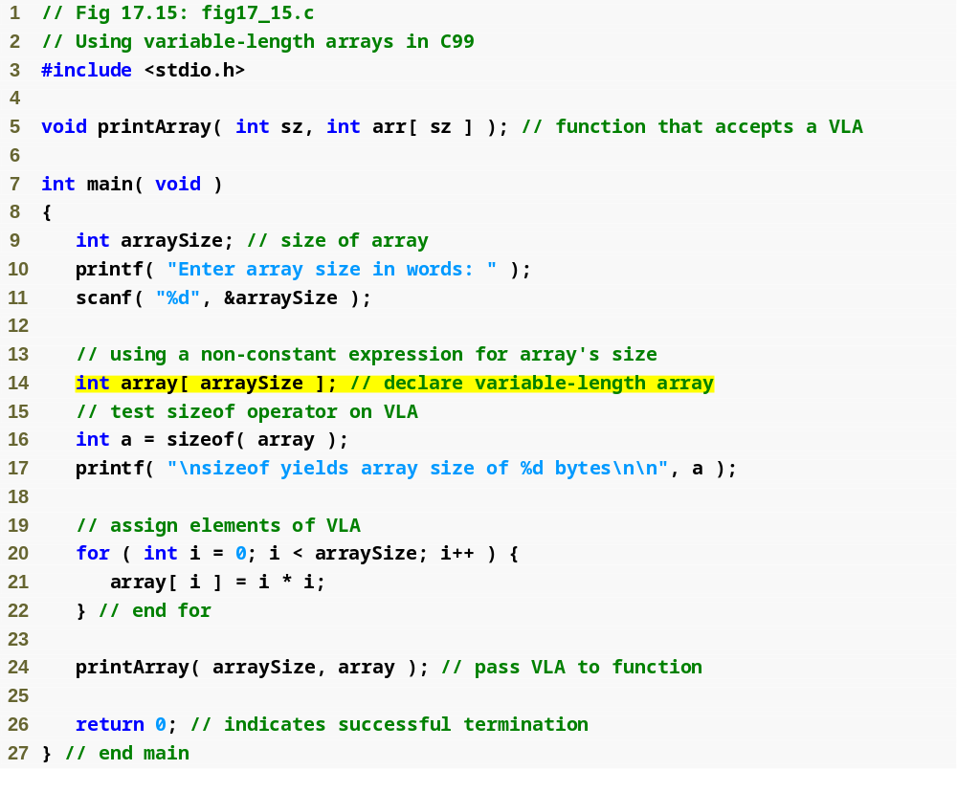
Outline
fig17_15.c
(1 of 2 )
Note that the array’s size is a variable entered by the user

Slide 37
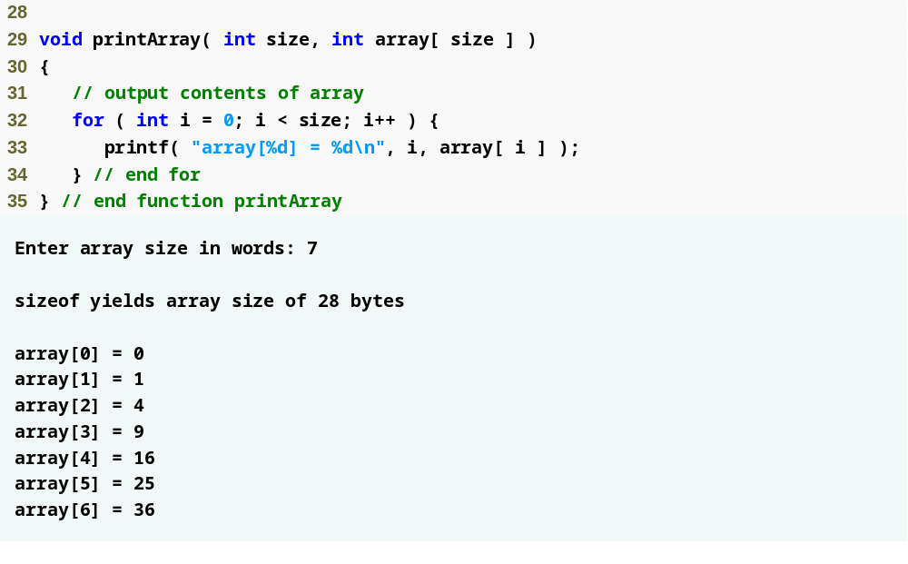
Outline
Function takes a variable-length array—note that the value of size must also be passed
fig17_15.c
(2 of 2 )

Slide 38
17.12 Other C99 Features
Extended Identifiers
  In C89, identifiers for variable names must be 31 characters or less for variables with internal linkage and 6 characters or less for variables with external linkage
  C99 increases this limit to 63 characters for internally-linked variables and 31 characters for externally-linked variables
The restrict keyword
  Declares restricted pointers—gives a portion of a program exclusive access to that location in memory
  Example for restricted pointer to an integer:
      int *restrict ptr;

Slide 39
17.12 Other C99 Features
Reliable Integer Division
  In C89, the behavior of integer division when the quotient is negative is implementation-dependent
    Some compilers round negative quotients toward 0, while others round the other way, toward negative infinity
  C99 always rounds negative quotients toward 0
Flexible Array Members
  C99 allows structs to contain an array of unspecified length
    Must be last member of struct, and cannot be only member
    Memory for the array must be dynamically allocated

Slide 40
17.12 Other C99 Features
long long int Type
  C99 defines type long long int for use on 64-bit systems
Type Generic Math
  The functions in C89’s math.h header only take one type
  C99 contains the tgmath.h header which contains math functions for all variable types
  Function prototypes are the same as those in math.h, but they will automatically call the correct version of the function depending on the argument type
    For example, if user calls sin(x), and x is a float (sin normally takes doubles), the function will instead call the tgmath.h function sinf, which takes floats

Slide 41
17.12 Other C99 Features
Inline Functions
  C99 allows inline functions (a feature of C++)
  Declared by placing inline before function declaration
  If a function is declared inline, the compiler will replace all calls to it with the function’s code body
  Improves performance, but may increase program’s size
Return Without Expression
  In C99, non-void functions must return a value
    Cannot use statement return;
    C89 allowed this but it could result in undefined behavior
  Likewise, void functions cannot return a value

Slide 42
17.12 Other C99 Features
Function snprintf
  C89 function sprintf writes into a buffer, but does not know how large the buffer is
    If text is too long, a “buffer overflow” occurs and information in memory following the buffer could be destroyed
  C99’s snprintf function takes the buffer size as an argument, preventing buffer overflows
  Most C compilers support this function, even those that are not C99-compliant

